Slide 1

Speech-to-Text and Sentiment Analysis
M Faizan 2022-BS-SE-081
Umair Rasheed 2022-BS-SE-082
M Hammad 2022-BS-SE-089
M Bilal 2022-BS-SE-130
Notes:
To use this title animation slide with a new image simply 1) move the top semi-transparent shape to the side, 2) delete placeholder image, 3) click on the picture icon to add a new picture, 4) Move semi-transparent shape back to original position, 5) Update text on slide.

Slide 2
Introduction
1
Converting speech to text
2
Analyzing sentiment from text
3
Generating audio feedback from text

Slide 3
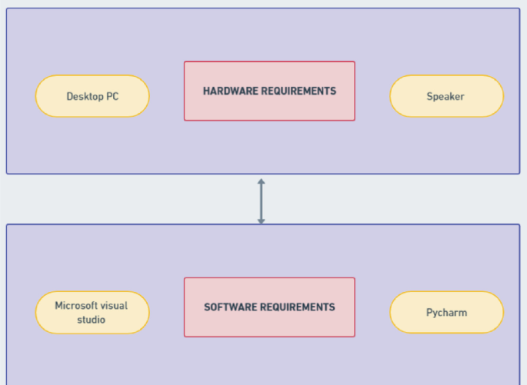
Hardware Requirement for Application

Slide 4
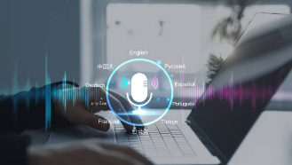
Background
1
2
3
Speech-to-Text
Sentiment Analysis
Key technological advancements

Slide 5
Methodology
1
Python Libraries
speech_recognition for capturing and converting voice.
nltk.sentiment for VADER-based sentiment analysis
gTTS for converting text reports to speech.
2
Hardware
Microphone for capturing user input.
3
Workflow
Voice input → Sentiment analysis → Speech output.

Slide 6
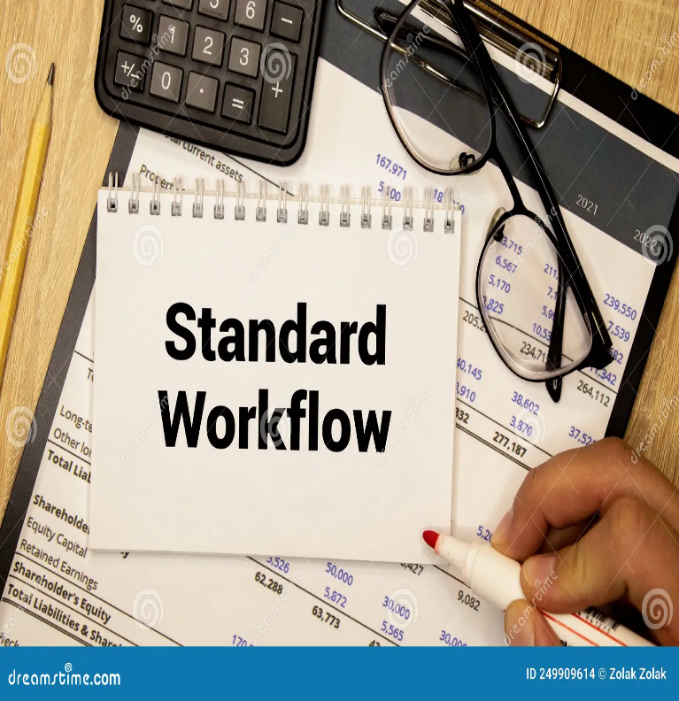
Methodology - Process Flow
Record voice using microphone
1
4
Generate a detailed sentiment report
Convert voice to text using Google Speech Recognition
2
5
Use gTTS to create audio feedback
Analyze the text for sentiment using VADER
3

Slide 7
Flowchart of the Program
1
2
3
4
5
Input voice using a microphone.
Convert speech to text
Perform sentiment analysis
Convert sentiment report to speech output.
Play the generated audio report

Slide 8
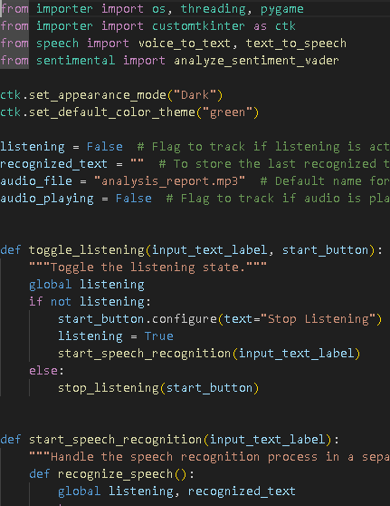
Code Overview
1
2
3
Capturing voice input.
Performing sentiment analysis
Generating speech output from results

Slide 9
Main Content - Voice-to-Text Functionality
Function: voice_to_text()
Uses speech_recognition to capture and process audio
Handles ambient noise and ensures clear input.
Outputs the spoken words as a string.
Example: "Please speak now" -> "You said: Hello World."

Slide 10
Libraries Used
SpeechRecognition
nltk
gTTS
customtkinter
Pillow
fpdf
matplotlib
os, tempfile, subprocess

Slide 11
Why These Libraries?
SpeechRecognition: Accurate speech-to-text conversion.
nltk: Sentiment analysis using VADER.
customtkinter: Modern GUI design.
gTTS: Text-to-speech functionality.
fpdf: PDF report generation.

Slide 12
Code Highlights

Slide 13
Demonstration Video

Slide 14
Conclusion
this project demonstrates the seamless integration of speech recognition, sentiment analysis, and text-to-speech functionalities within a user-friendly GUI application. By leveraging Python's versatile libraries, it showcases a practical solution for real-world challenges, with opportunities for future enhancements like multi-language support and mobile compatibility.

